Slide 1
Chapter 6: Introduction to Inference
6.1 Estimating with Confidence
6.2 Tests of Significance
6.3 Use and Abuse of Tests
6.4 Power and Inference as a Decision

Slide 2
6.1 Estimating with Confidence
Overview of Inference
Statistical confidence
Confidence intervals
Confidence interval for a population mean
How confidence intervals behave
Choosing the sample size
Some Cautions

Slide 3
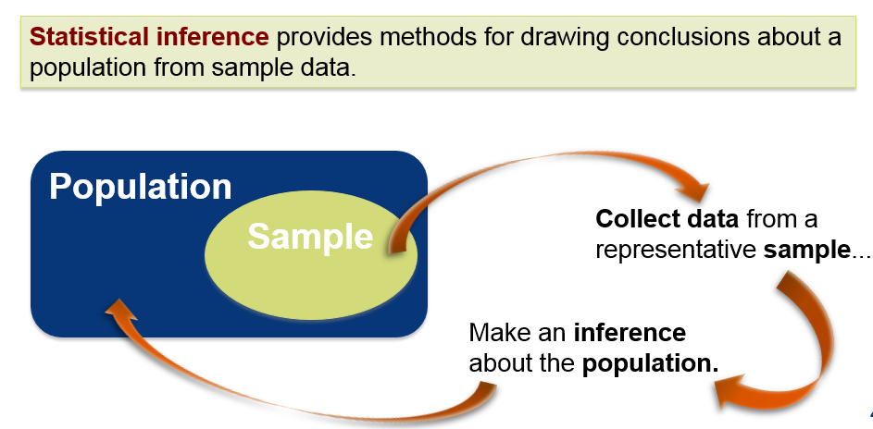
Statistical Inference

Slide 4
Overview of Inference
Statistical Inference involves two prominent techniques:
Confidence Intervals
Hypothesis Tests
In both techniques, we ask “What would happen if we used the method many times?”
Formal statistical inference is based on sampling distributions. When you see statistical inference, you should act as if your data comes from a random sample or a randomized experiment.

Slide 5
Simple Conditions for Inference About a Mean
Simple Conditions for Inference About a Mean
We have an SRS from the population of interest. There is no nonresponse or other practical difficulty.
The variable we measure has an exactly Normal distribution N(μ,σ) in the population.
We don not know the population mean μ, but we do know the population standard deviation σ.
Note: The conditions that we have a perfect SRS, that the population is exactly Normal, and that we know the population standard deviation are all unrealistic.

Slide 6
Statistical Estimation
Example:
Suppose a sample of the heights of 100 college age females is taken and it is found that the sample mean is 64.5.
Because the sample mean is 64.5, we could guess that µ is “somewhere” around 64.5. How close to 65.5 is µ (the mean height of all college age females) likely to be?
How would the sample mean vary if we took many SRSs of size 80 from population?

Slide 7
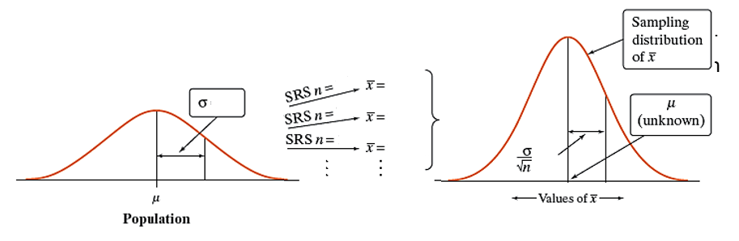
Statistical Estimation Suppose we know standard deviation is 3.

Slide 8
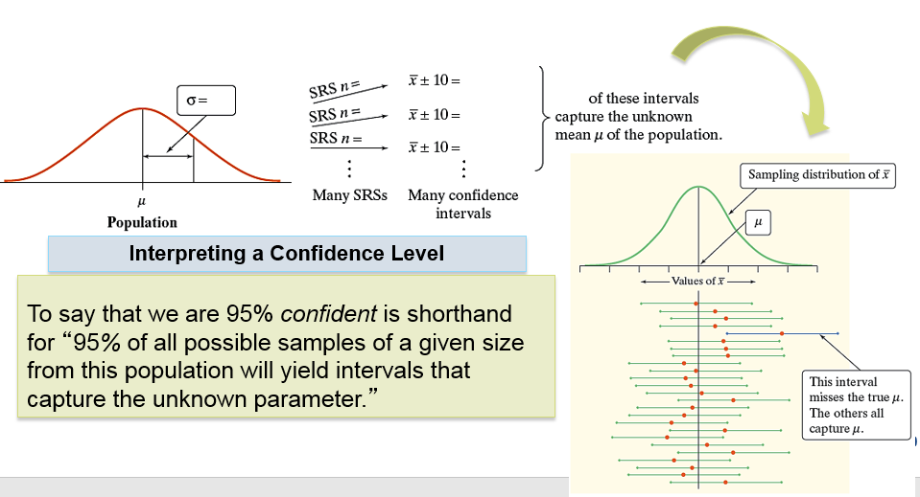


Statistical Estimation

Slide 9
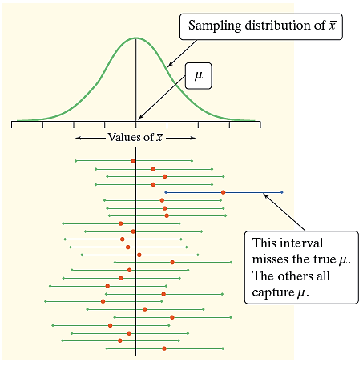
Statistical Confidence
To say that we are 95.44% confident is
shorthand for
“95.44% of all possible samples of a given
size from this population will yield
intervals that capture the unknown
parameter.”

Slide 10
Confidence Interval
The Big Idea: The sampling distribution of tells us how close to µ the sample mean is likely to be. All confidence intervals we construct will have a form similar to this:
estimate ± margin of error
A level C confidence interval for a parameter has two parts:
An interval calculated from the data, which has the form
estimate ± margin of error
A confidence level C, where C is the probability that the interval will capture the true parameter value in repeated samples. In other words, the confidence level is the success rate for the method.
We usually choose a confidence level of 90% or higher because we want to be quite sure of our conclusions. The most common confidence level is 95%.

Slide 11
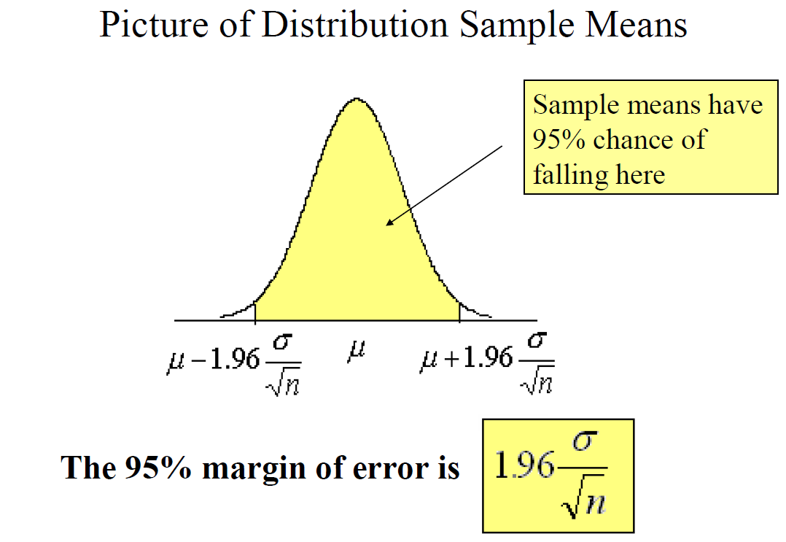

Slide 12
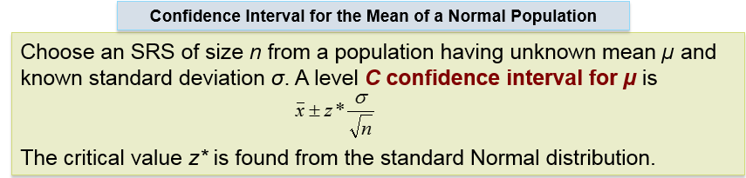
Confidence Interval for a Population Mean

Slide 13
Confidence Interval for a Population Mean
Example:
Suppose a sample of the heights of 100 college age females is taken and it is found that the sample mean is 65.5, standard deviation is 3. Find the 95% margin of error (M.O.E), and 95% confidence interval(C.I).
95% M.O.E:
95% C.I:

Slide 14
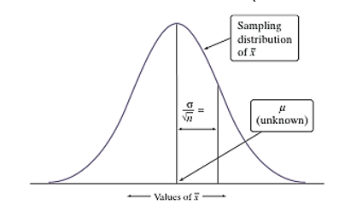
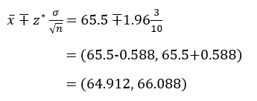
Confidence Interval for a Population Mean

Slide 15
Finding Specific z* Values
We can use a Z-table. For a particular confidence level, C.
We can also use software. In Excel:
=NORMINV(probability, mean, standard_dev) gives z for a given cumulative probability.
Example: For a 98% confidence level, =NORMINV(.01,0,1) = −2.32635

Slide 16
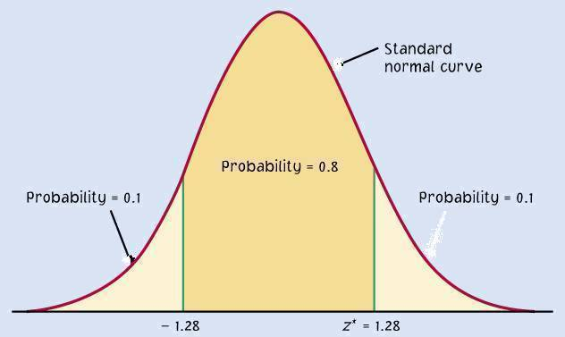
The Margin of Error
The confidence level C determines the value of z* (in Table D).
The margin of error also depends on z*.
C
m m
−z*
z*

Slide 17
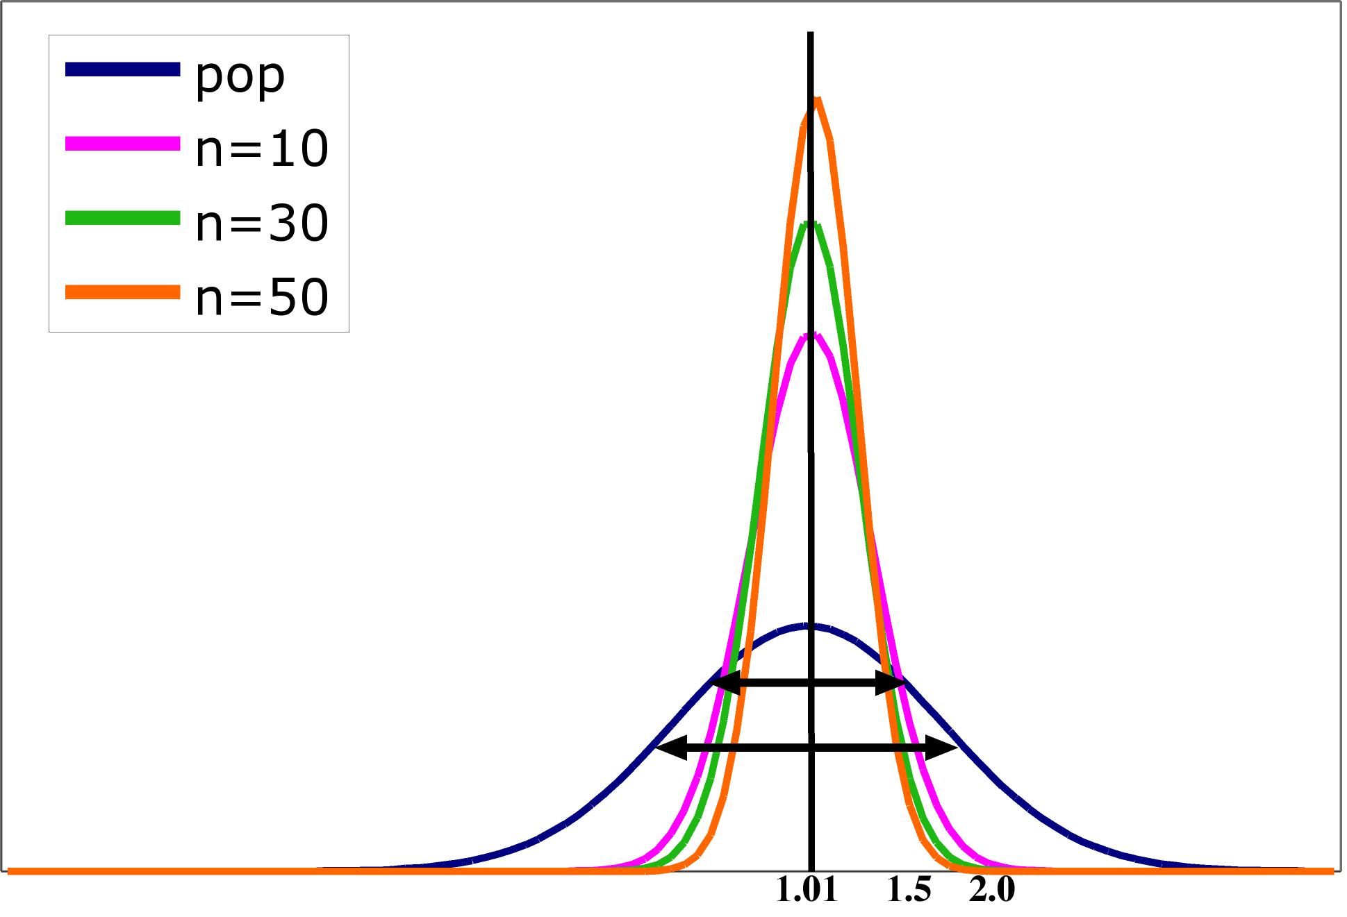
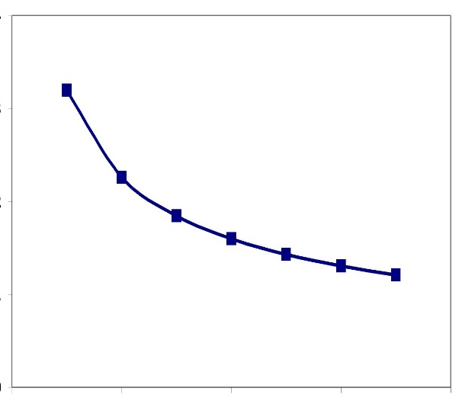

Impact of Sample Size to M.O.E
The spread in the sampling distribution of the mean is a function of the number of individuals per sample.
The larger the sample size, the smaller the standard deviation (spread) of the sample mean distribution.
The spread decreases at a rate equal to √n.
Standard error σ ⁄ √n
Sample size n

Slide 18
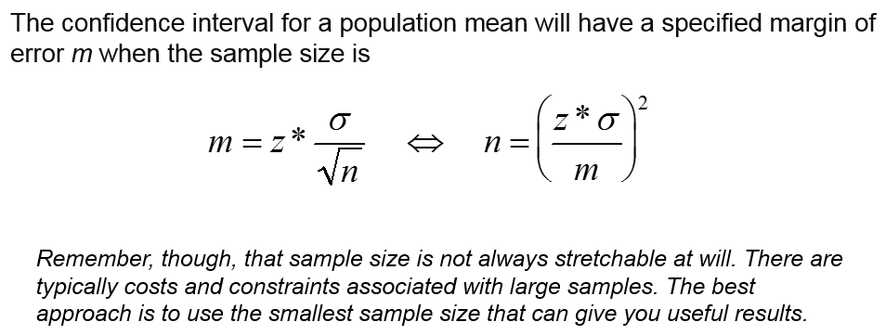
Choosing the Sample Size

Slide 19

Example
How many undergraduates should we survey?
Suppose we are planning a survey about college savings programs. We want the margin of error of the amount contributed to be $30 with 95% confidence. Let us assume the population standard deviation, σ, equals $1483.
How many measurements should you take?
For a 95% confidence interval, z* = 1.96.
Using only 9387 measurements will not be enough to ensure that m is no more than $30. Therefore, we need at least 9388 measurements.

Slide 20
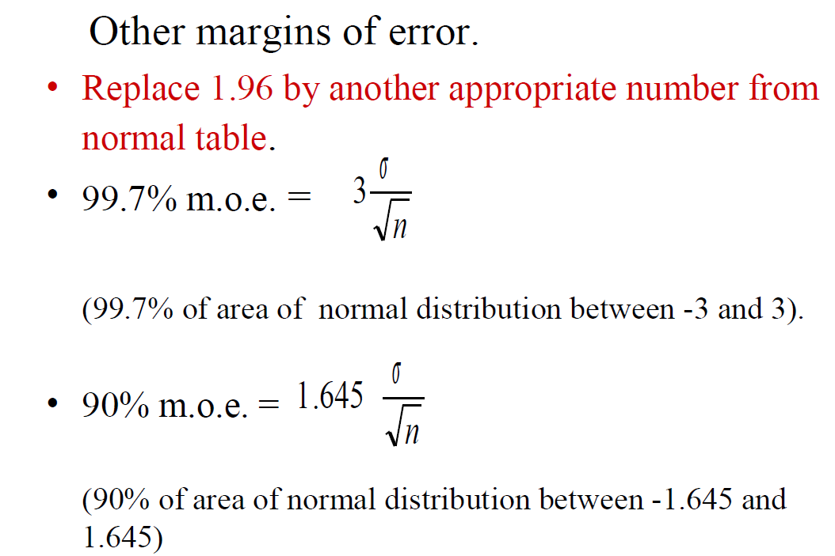

Slide 21
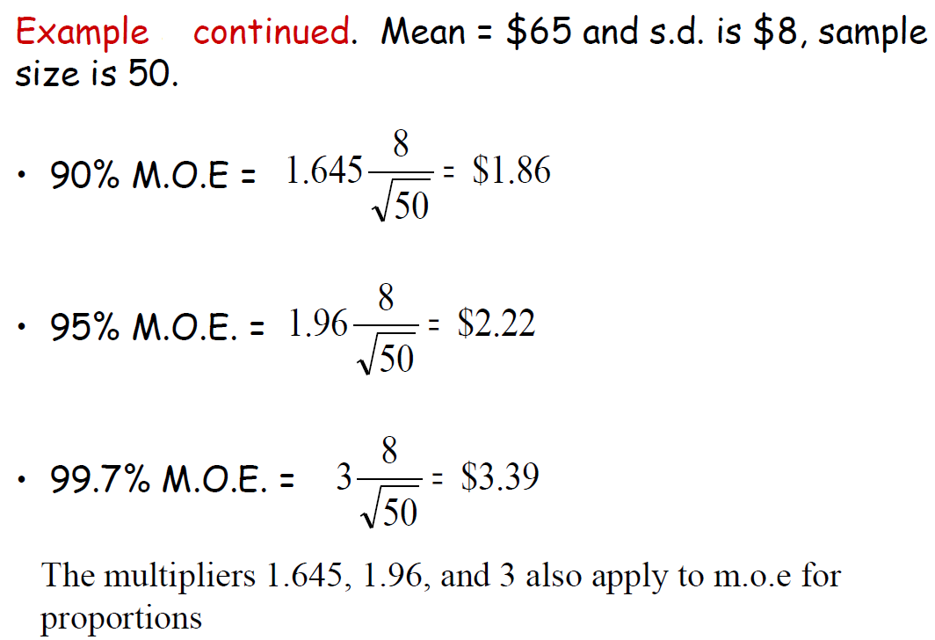
Example of Other M.O.E
The April utility bills of a random sample of 50 apartment dwellers had a sample mean of $65 and a standard deviation of $8. What are the 90%, 95%, and 99.7% margins of error of the sample mean?

Slide 22
Example Confidence Interval
A standardized exam has a normal distribution with population standard deviation 20. Suppose that a group of 25 students had special tutoring and ended up with a group average of 285. Find 90% C.I.
90% M.O.E
90% C.I

Slide 23
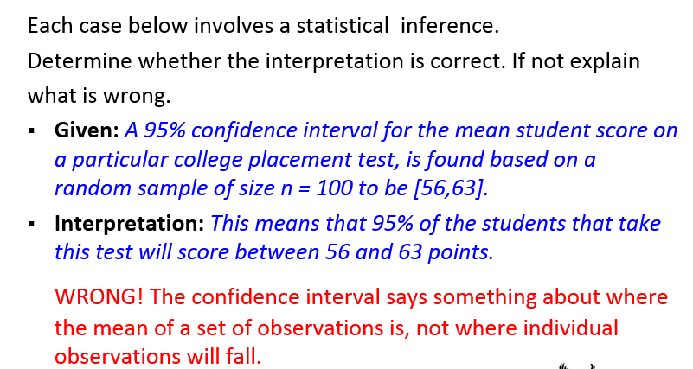
DOs and DON’Ts for Confidence Intervals

Slide 24
DOs and DON’Ts for Confidence Intervals
Each case below involves a statistical inference.
Determine whether the interpretation is correct. If not explain
what is wrong.
Given: A 90% confidence interval for the mean of a normal population is calculated based on a random sample of n = 10 observations.
Interpretation: This means that there is 90% chance that this confidence interval will include the true (unknown) population mean.
CORRECT! NOTE : The fact that the sample is small does not impact the truthfulness of the statement, as long as the correct method is used when calculating the confidence interval.

Slide 25
Some Cautions
The data should be an SRS from the population.
The confidence interval and sample size formulas are not correct for other sampling methods.
Inference cannot rescue badly produced data.
Confidence intervals are not resistant to outliers.
If n is small (<15) and the population is not Normal, the true confidence level will be different from C = 1-a.
The standard deviation σ of the population must be known.
The margin of error in a confidence interval covers only random sampling errors!

Slide 26
6.2 Tests of Significance
The reasoning of tests of significance
Stating hypotheses
Test statistics
P-values
Statistical significance
Tests for a population mean
Two-sided significance tests and confidence intervals

Slide 27
Statistical Inference
Confidence intervals are one of the two most common types of statistical inference. Use a confidence interval when your goal is to estimate a population parameter. The second common type of inference, called tests of significance, has a different goal: to assess evidence in the data about some claim concerning a population.
A test of significance is a formal procedure for comparing observed data with a claim (also called a hypothesis) whose truth we want to assess.
The claim is a statement about a parameter such as the population proportion p or the population mean µ.
We express the results of a significance test in terms of a probability, called the P-value, which measures how well the data and the claim agree.

Slide 28
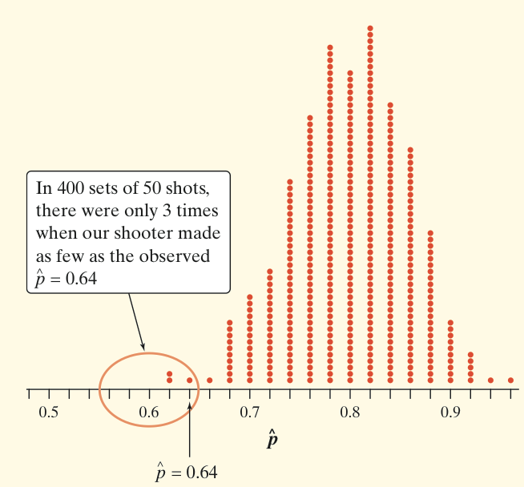
The Reasoning of Tests of Significance
Suppose a basketball player claimed to be an 80% free-throw shooter. To test this claim, we have him attempt 50 free throws. He makes 32 of them. His sample proportion of made shots is 32/50 = 0.64.
What can we conclude about the claim based on this sample data?
We can use software to simulate 400 sets of 50 shots each on the assumption that the player is an 80% free-throw shooter.
You can say how strong the evidence against the player’s claim is by giving the probability that he would make as few as 32 out of 50 free throws if he really makes 80% in the long run.
Assuming that the actual parameter value is p = 0.80, the observed statistic is so unlikely that it gives convincing evidence that the player’s claim is not true.

Slide 29
Stating Hypotheses
A significance test starts with a careful statement of the claims we want to compare.
The claim tested by a statistical test is called the null hypothesis (H₀). The test is designed to assess the strength of the evidence against the null hypothesis. Often, the null hypothesis is a statement of “no effect” or “no difference in the true means.”
The claim about the population for which we’re trying to find evidence is the alternative hypothesis (H_{a}). The alternative is one-sided if it states either that a parameter is (1) larger than the null hypothesis value, or (2) smaller than the null hypothesis value. It is two-sided if it states that the parameter is different from the null value.
In the free-throw shooter example, let p be the true long-run proportion of made free throws, and suppose our hypotheses are
H₀: p = 0.80 H_{a}: p < 0.80.
Here, H_{a} is a one-sided alternative.

Slide 30
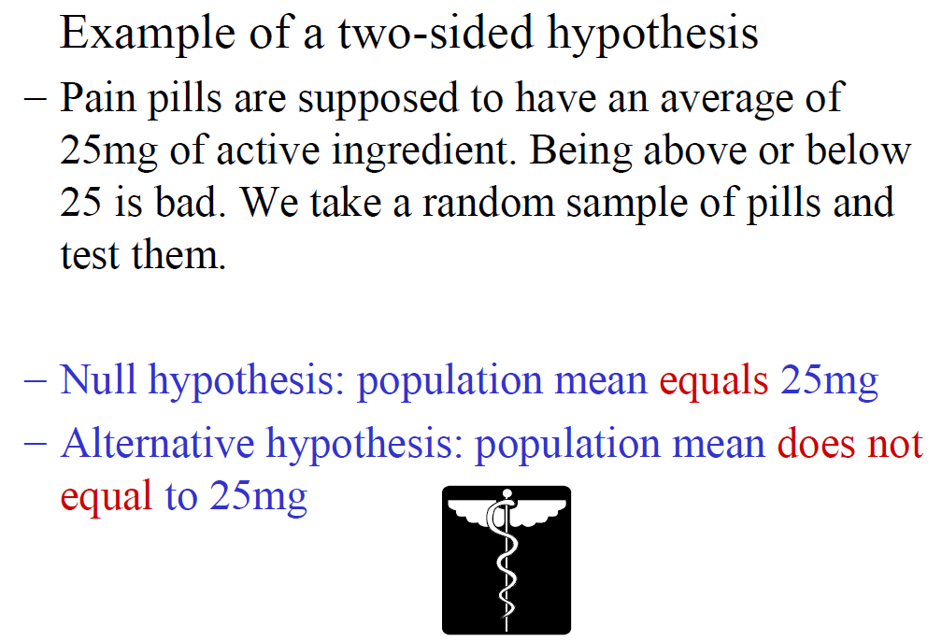

Slide 31
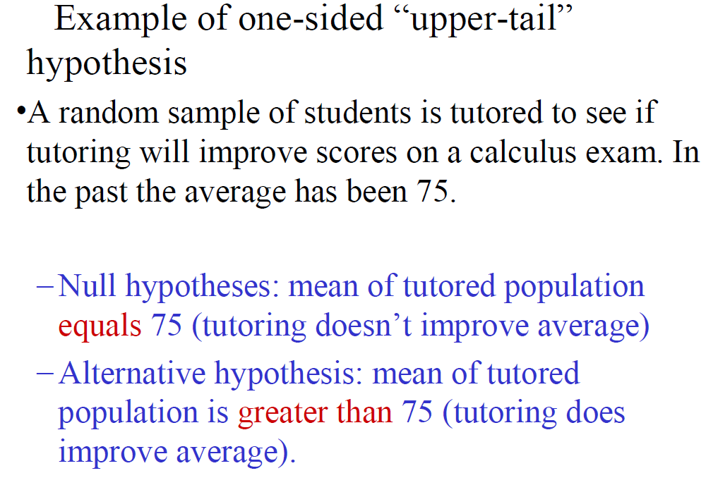

Slide 33
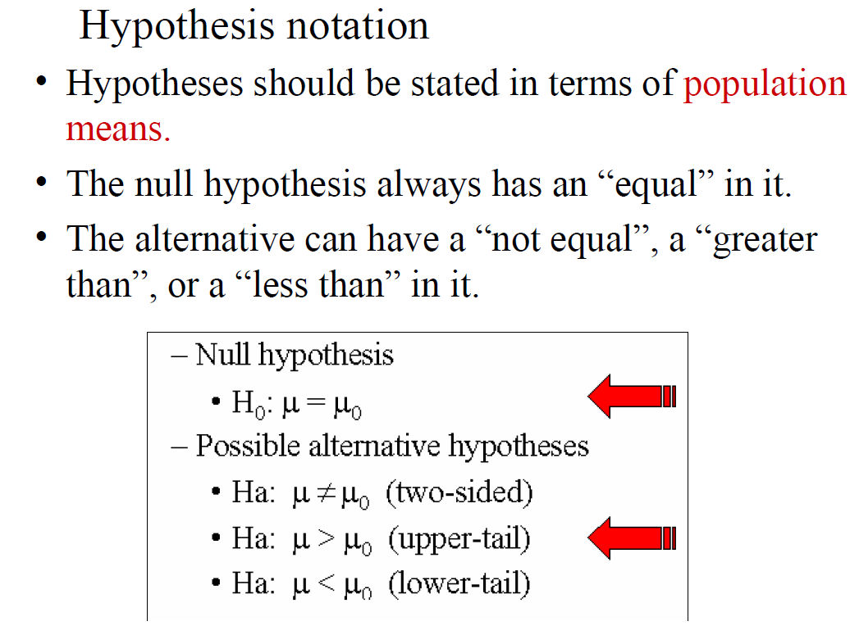

Slide 34
Four Steps of Tests for 5% Level of significance
State the null and alternative hypotheses.
2. Calculate the value of the test statistic.
3. Find the P-value or Critical Value for the observed data.
4. State a conclusion.

Slide 35
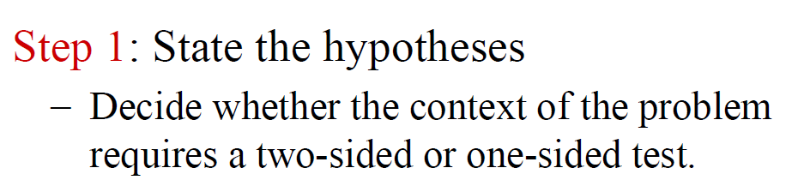
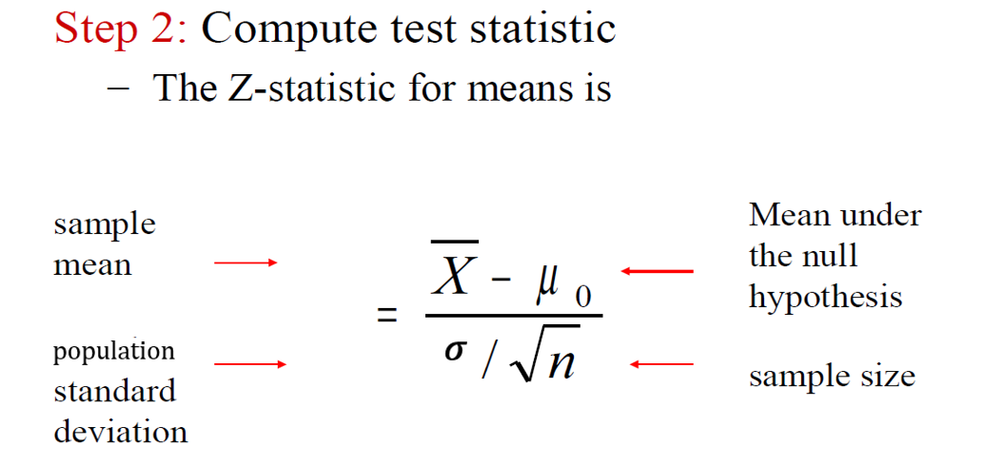




Slide 36
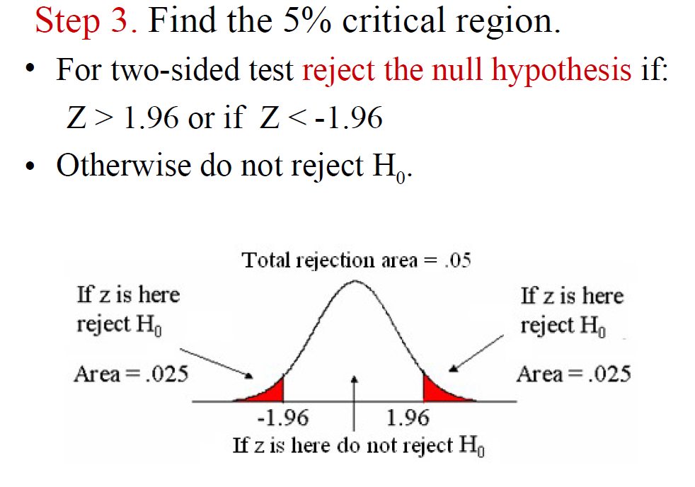

Slide 37
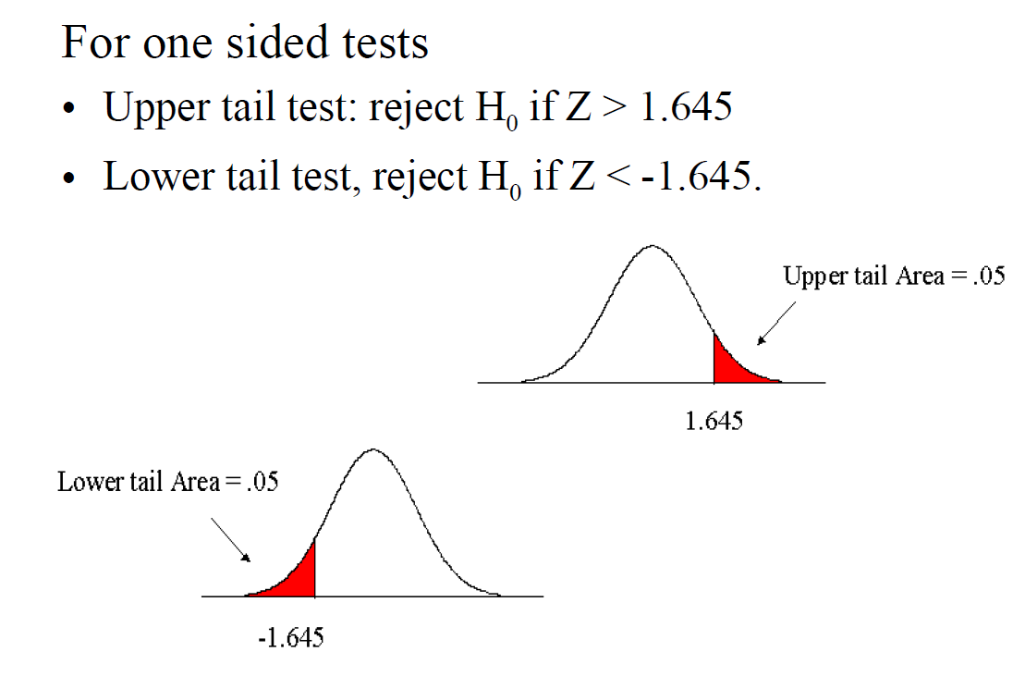

Slide 38

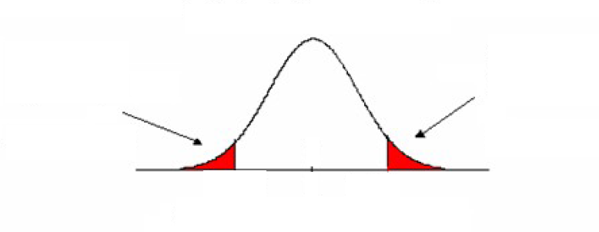


Find the P-value
For two-sided test reject the null hypothesis if: P-value <𝝰 (here 𝝰=0.05)

Slide 39
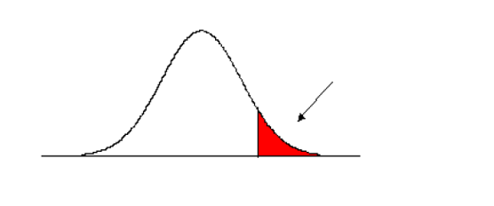



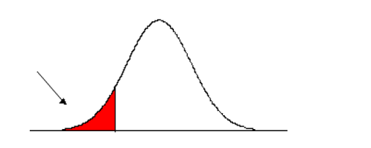


Find P-value
Upper tail test:
reject Ho if P-value < 𝜶
Lower tail test:
reject Ho if P-value < 𝜶

Slide 40
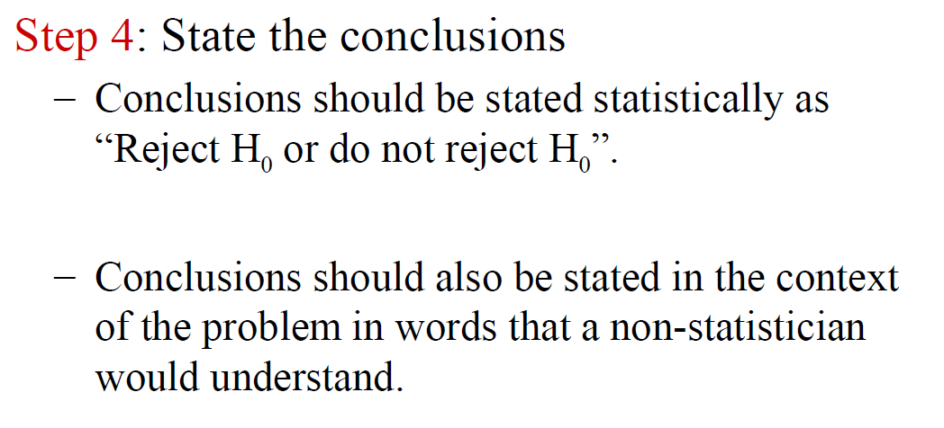

Slide 41
Example
Burger Barn claims that its hamburgers weigh 0.25 lbs. A random sample of 16 such burgers gave a sample mean 0.22 lbs. We would like to know if Burger Barn’s claim of 0.25 lbs is correct or not. Suppose the Burger Barn’s hamburgers weights have a normal distribution with a standard deviation of 0.04 lbs.

Slide 42
Example
Suppose the amount of active ingredient in some pain pill follows a Normal distribution with standard deviation σ =1.2. We doubt that the amount of active ingredient in pain pill is less than 25 mg as advertised. A random sample of 36 pills gives a sample mean of 24.8

Slide 43
Example of hypothesis test
Suppose the amount of active ingredient in some pain pill follows a Normal distribution with standard deviation s =1.2. We doubt that the amount of active ingredient in pain pill is more than 36 mg as advertised. A random sample of 36 pills gives a sample mean of 25.4

Slide 44
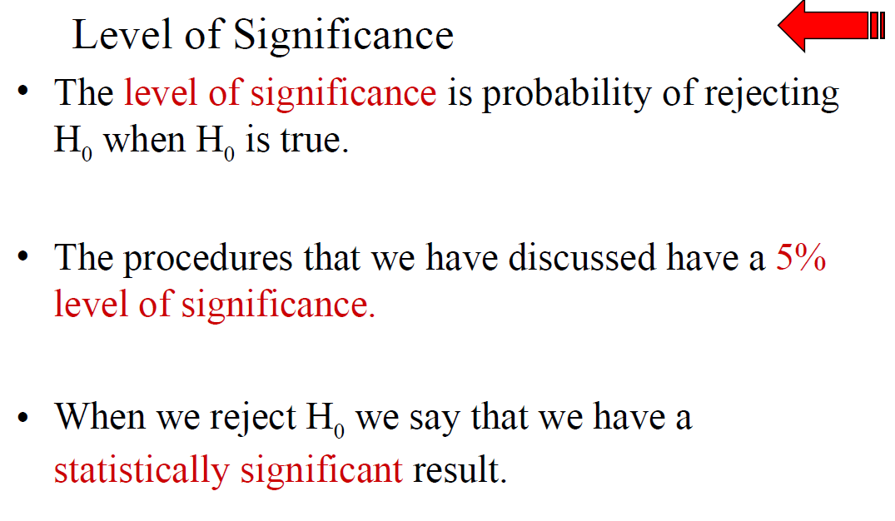

Slide 45
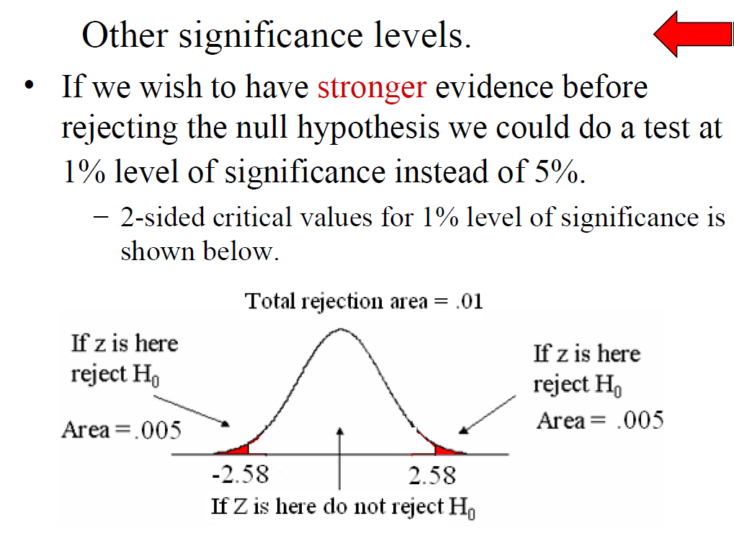

Slide 46
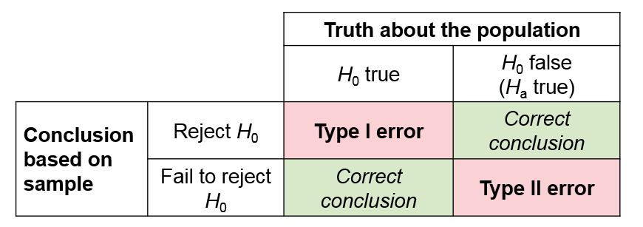
6.3 Use and Abuse of Tests
There is no sharp border between “significant” and “not significant”, only increasingly strong evidence as the p-value decreases.
2. Beware of outliers.
3. Formal statistical inference cannot correct basic flaws in the design.

Slide 47
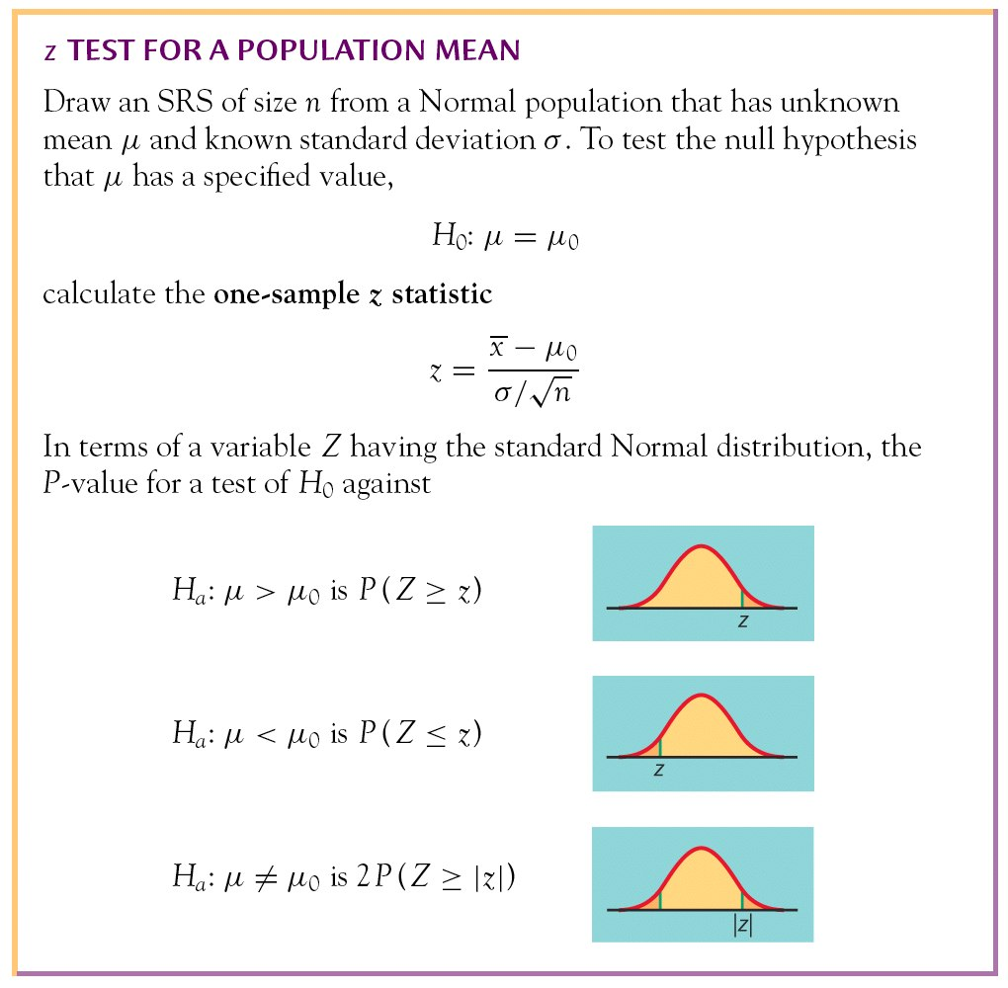
Tests for a Population Mean

Slide 48
Four Steps of Tests of Significance
Tests of Significance: Four Steps
1. State the null and alternative hypotheses.
2. Calculate the value of the test statistic.
3. Find the P-value for the observed data.
4. State a conclusion.
We will learn the details of many tests of significance in the following chapters. The proper test statistic is determined by the hypotheses and the data collection design.

